Slide 1
Model Validation

Slide 2
Thinking models
Selecting model
Choosing appropriate model hyper parameters
What if model perfectly fit on training data?
Is Model general?

Slide 3
Test-Train split
Second dataset -> validation set
Validation set could help us to judge predictive performance of our model
Validation set could be created by just removing few examples from training set

Slide 4
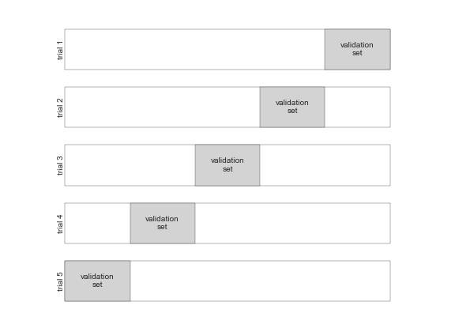
Cross-validation
Disadvantage of just splitting data set in train and validation is we miss chunk of validation data in training.
Leave one out

Slide 5
Selecting the Best Model
If our estimator underperforms then what should we do?
Use a more complicated/more flexible model
Use a less complicated/less flexible model
Gather more training samples
Gather more data to add features to each sample
sometimes using a more complicated model will give worse result, and adding more training samples may not improve your results

Slide 6
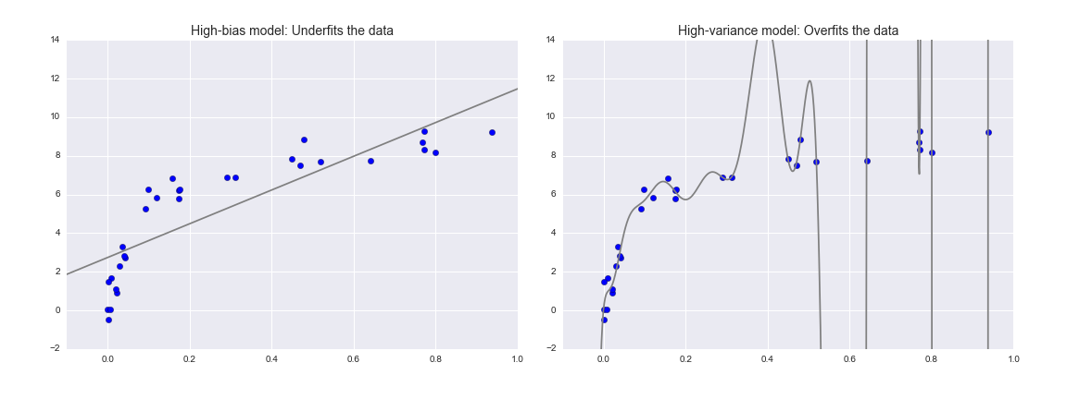
The Bias-variance trade-off
the question of "the best model" is about finding a sweet spot in the tradeoff between bias and variance.

Slide 7
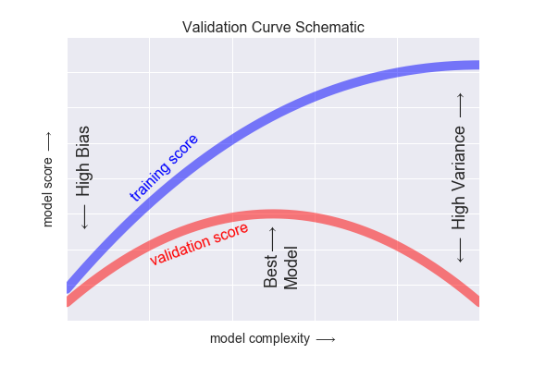
The Bias-variance trade-off

